Slide 1

Convolutional Neural Network (CNN) | INTRODUCTION
Feature extraction
Input Layer
Hidden Layer
Input classification
Fully connected Layer
Output Layer

Slide 2
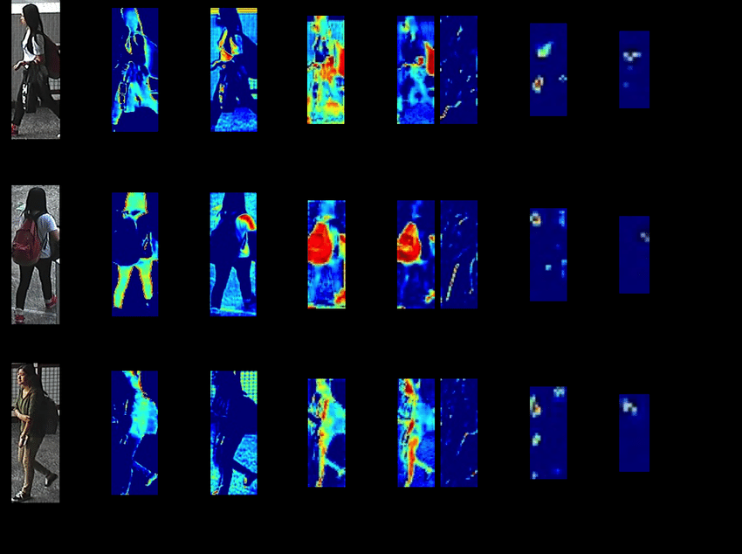
Convolutional Neural Network (CNN) | INTRODUCTION
Feature extraction
Input Layer
Hidden Layer
Input classification
Fully connected Layer
Output Layer

Slide 3
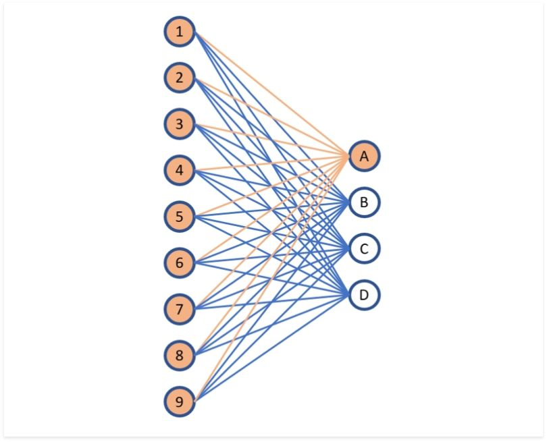
Convolutional Neural Network (CNN) | INTRODUCTION
Feature extraction
Input Layer
Hidden Layer
Input classification
Fully connected Layer
Output Layer

Slide 4
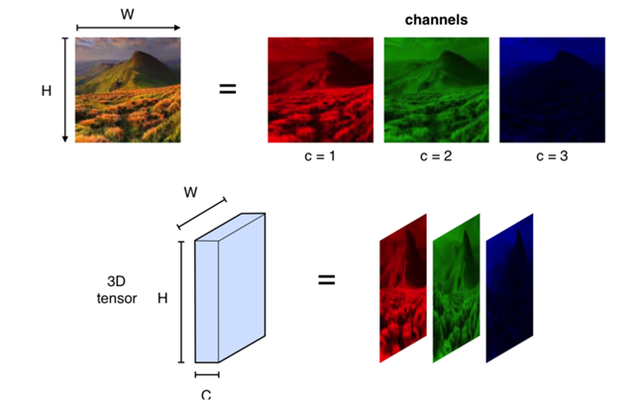
Convolutional Neural Network (CNN) | INTRODUCTION
Feature extraction
Input Layer
Hidden Layer
Input classification
Fully connected Layer
Output Layer

Slide 5
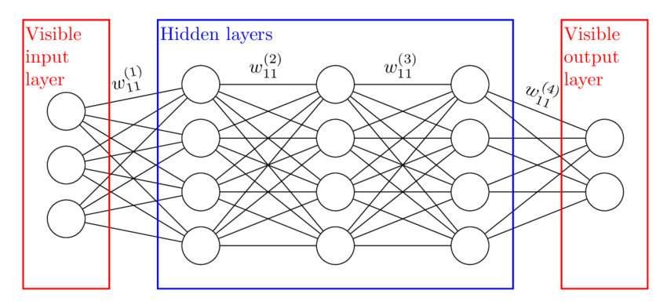
Convolutional Neural Network (CNN) | INTRODUCTION
Feature extraction
Input Layer
Hidden Layer
Input classification
Fully connected Layer
Output Layer

Slide 6
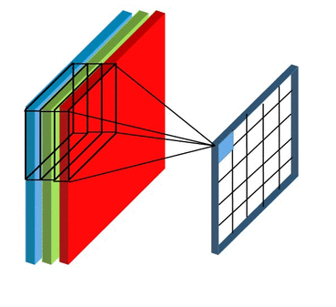
Convolutional Neural Network (CNN) | INTRODUCTION
Feature extraction
Input Layer
Hidden Layer
Convolution
Activation
Pooling
Input classification
Fully connected Layer
Output Layer

Slide 7
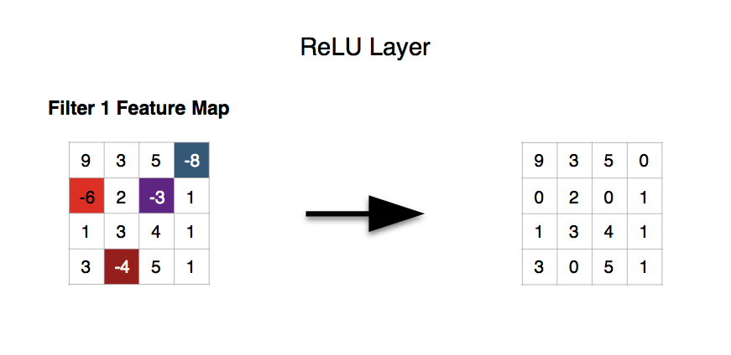
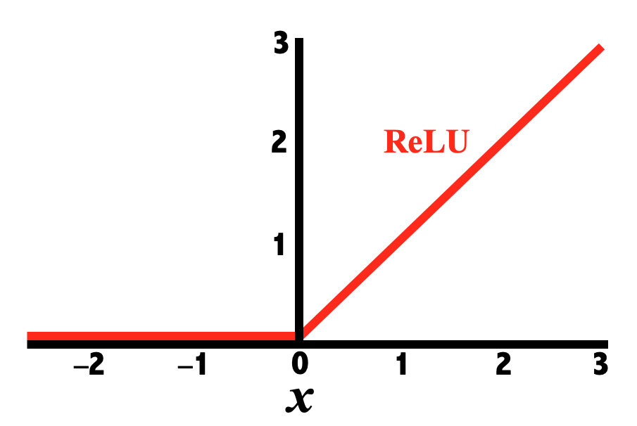
Convolutional Neural Network (CNN) | INTRODUCTION
Feature extraction
Input Layer
Hidden Layer
Convolution
Activation
Pooling
Input classification
Fully connected Layer
Output Layer

Slide 8
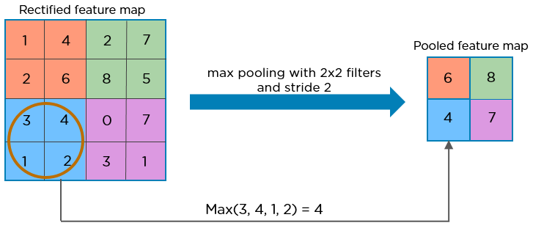
Convolutional Neural Network (CNN) | INTRODUCTION
Feature extraction
Input Layer
Hidden Layer
Convolution
Activation
Pooling
Input classification
Fully connected Layer
Output Layer

Slide 9
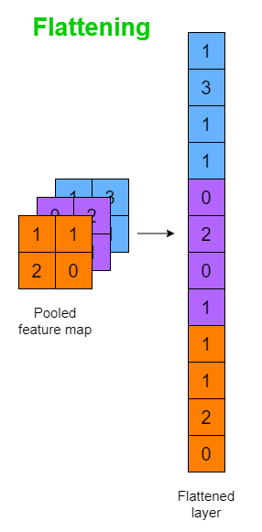
Convolutional Neural Network (CNN) | INTRODUCTION
Feature extraction
Input Layer
Hidden Layer
Input classification
Fully connected Layer
Output Layer

Slide 10
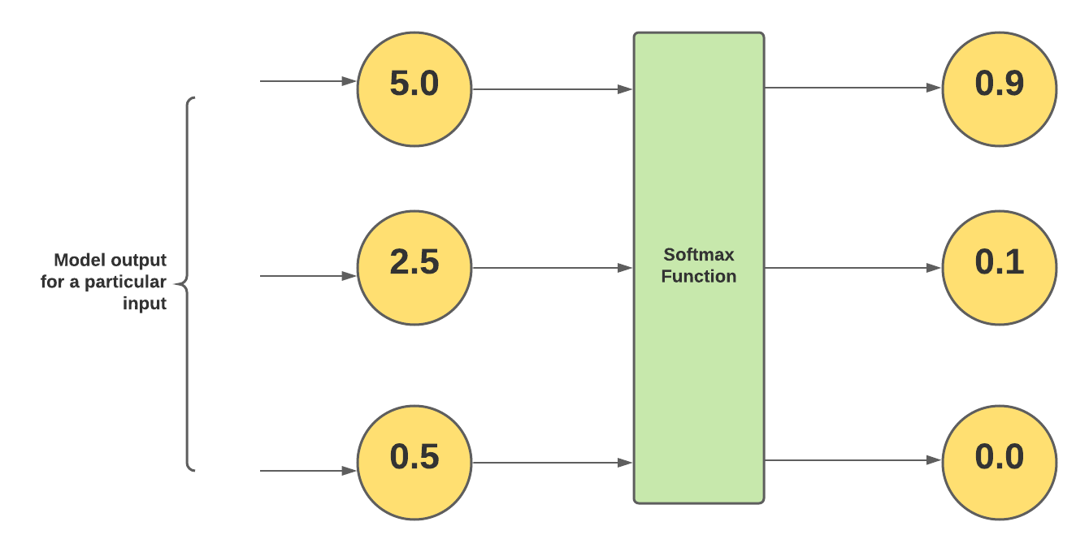
Convolutional Neural Network (CNN) | INTRODUCTION
Feature extraction
Input Layer
Hidden Layer
Input classification
Fully connected Layer
Output Layer

Slide 11
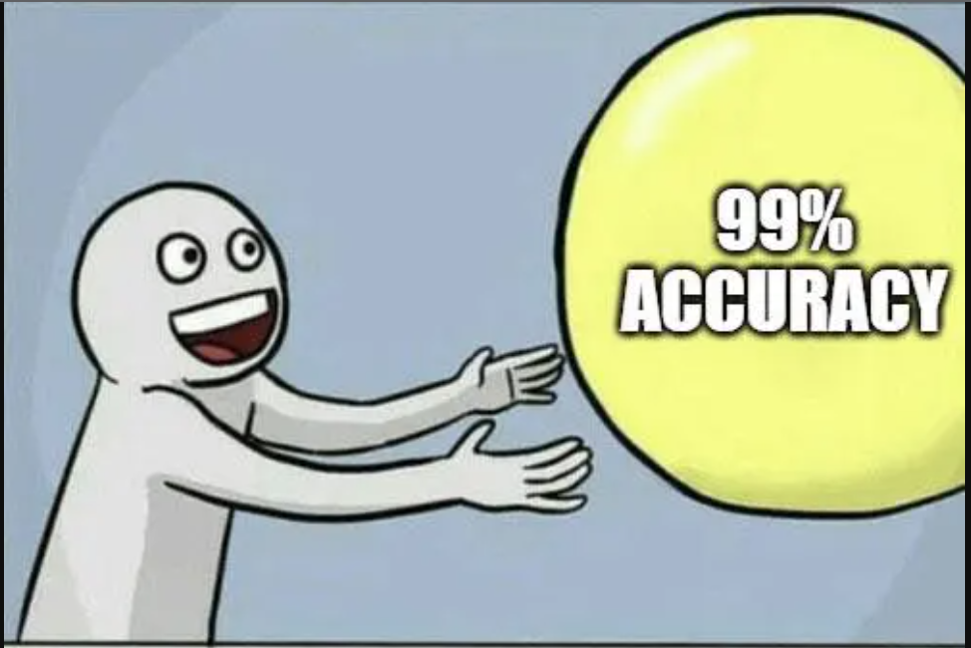
Convolutional Neural Network (CNN) | EXPERIMENT
Input Data Augmentation
Hidden Layer Composition
Hyperparameter Tunning

Slide 12

Convolutional Neural Network (CNN) | EXPERIMENT
Input Data Augmentation
Hidden Layer Composition
Hyperparameter Tunning

Slide 13
Convolutional Neural Network (CNN) | EXPERIMENT
Input Data Augmentation
Hidden Layer Composition
Hyperparameter Tunning
Train Folder 1500
Test Folder 1500
Combined 3000
Training 2400
Validation 300
Testing 300
15 Categories

Slide 14
Convolutional Neural Network (CNN) | EXPERIMENT
imds = imageDatastore(cat(1,imds1.Files,imds2.Files));
imds.Labels = cat(1,imds1.Labels,imds2.Labels);
[trainDataDS, rest] = splitEachLabel(imds, 0.8, 'randomized');
[validateDataDS, testDataDS] = splitEachLabel(rest, 0.5, 'randomized');
Input Data Augmentation
Hidden Layer Composition
Hyperparameter Tunning

Slide 15
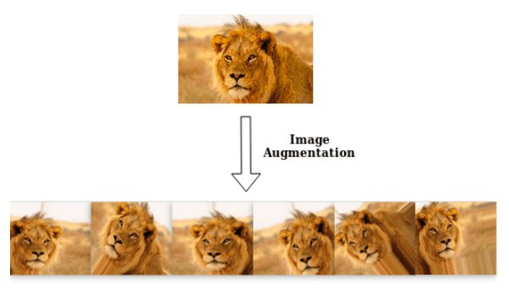
Convolutional Neural Network (CNN) | EXPERIMENT
Input Data Augmentation
Rotation
Shearing
Translation
Reflection
Hidden Layer Composition
Hyperparameter Tunning

Slide 16
Convolutional Neural Network (CNN) | EXPERIMENT
imageAugmenter = imageDataAugmenter( ...
'RandRotation',[-20 20], ...
'RandXShear', [0 45], ...
'RandYShear', [0 45], ...
'RandXReflection', 1, ...
'RandYReflection', 1, ...
'RandXTranslation',[-3 3], ...
'RandYTranslation',[-3 3]);
trainData = augmentedImageDatastore(img_size, trainDataDS, 'DataAugmentation',imageAugmenter);
Input Data Augmentation
Rotation
Shearing
Translation
Reflection
Hidden Layer Composition
Hyperparameter Tunning

Slide 17
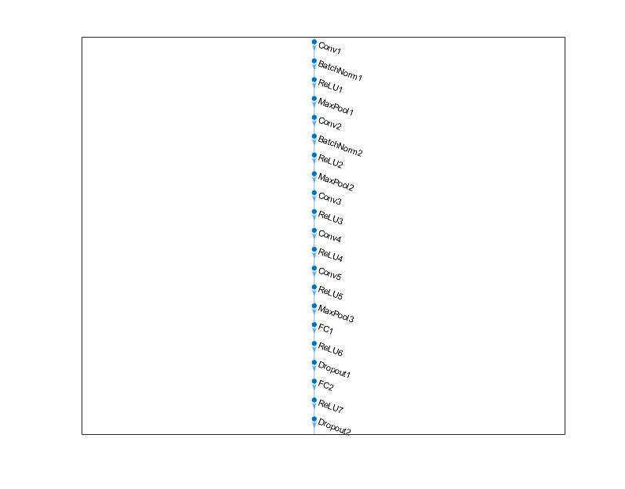
Convolutional Neural Network (CNN) | EXPERIMENT
Input Data Augmentation
Hidden Layer Composition
AlphaNet
7 hidden layers
5 convolution layers
2 fully connected layers
BetaNet
Hyperparameter Tunning

Slide 18
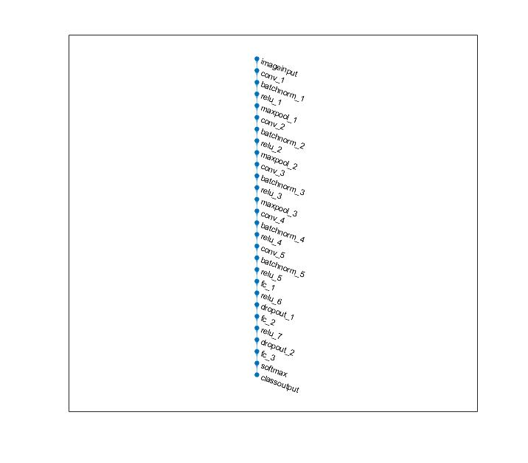
Convolutional Neural Network (CNN) | EXPERIMENT
Input Data Augmentation
Hidden Layer Composition
AlphaNet
BetaNet
8 hidden layers
5 convolution layers
3 fully connected layers
Hyperparameter Tunning

Slide 19
Convolutional Neural Network (CNN) | EXPERIMENT
Input Data Augmentation
Hidden Layer Composition
Hyperparameter Tunning
 | Exp 1 | Exp 2 | Exp 3
Optimizer | Adam* | Sgdm*
Epochs | 25 | 35 | 55
Batch size | 64 | 128 | 256
Learning rate | 0.01 | 0.05 | 0.001
adam - Adaptive Moment Estimation
sgdm - Stochastic Gradient Descent with Momentum

Slide 20
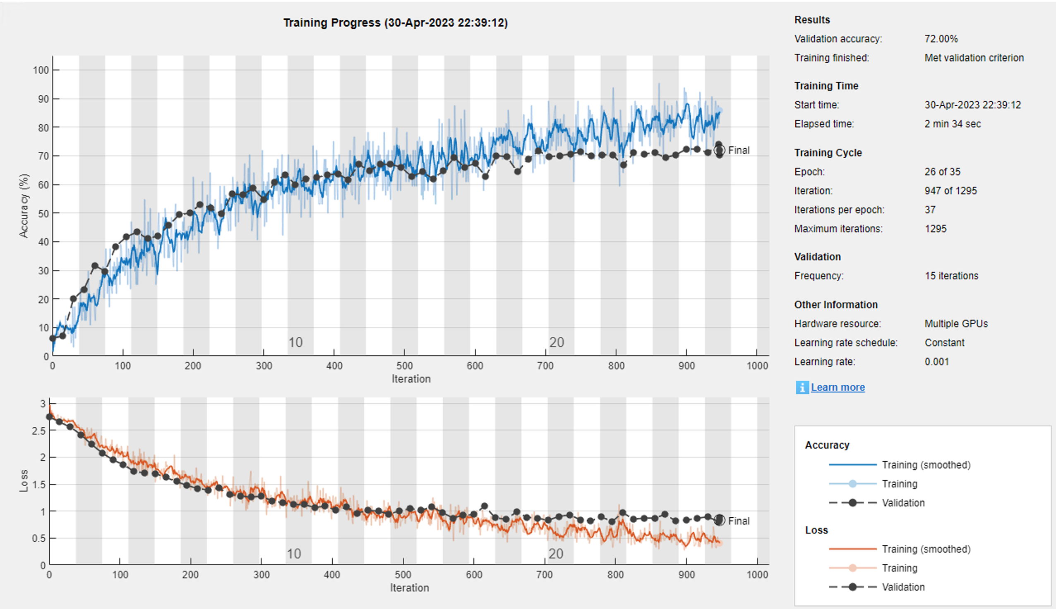
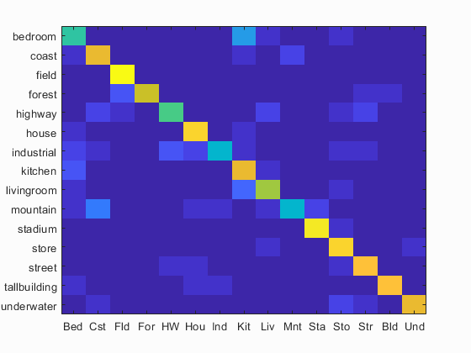
Convolutional Neural Network (CNN) | RESULTS
AlphaNet
Original data training
Augmented data training
BetaNet
Accuracy (mean of diagonal of confusion matrix) is 0.757

Slide 21
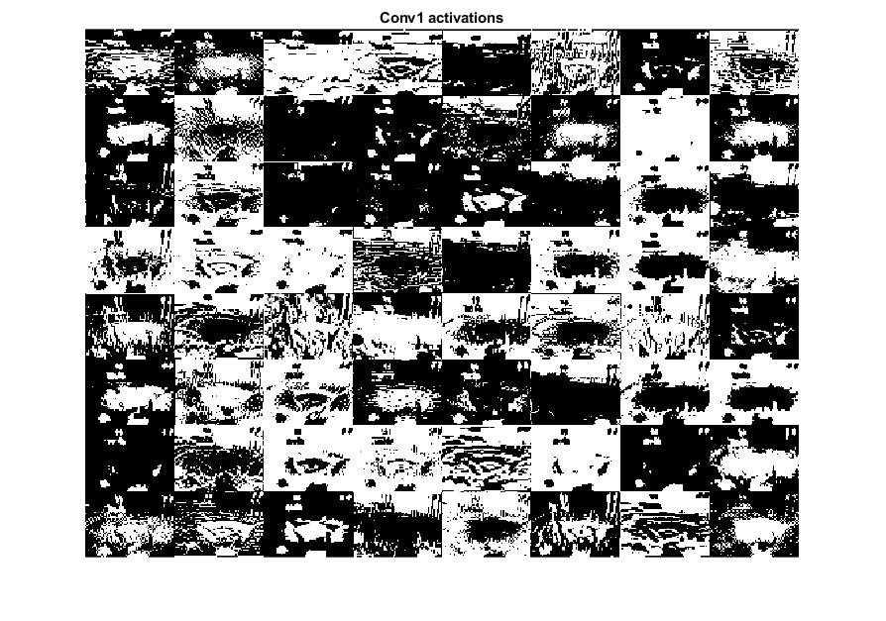
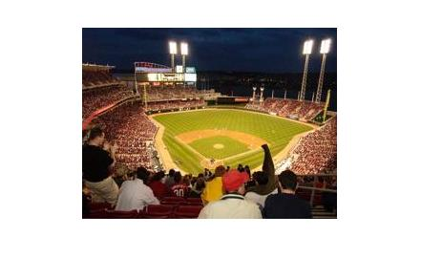
Convolutional Neural Network (CNN) | RESULTS
AlphaNet
Original data training
Feature map (1st convolution)
Feature map (5th convolution)
Augmented data training
BetaNet

Slide 22
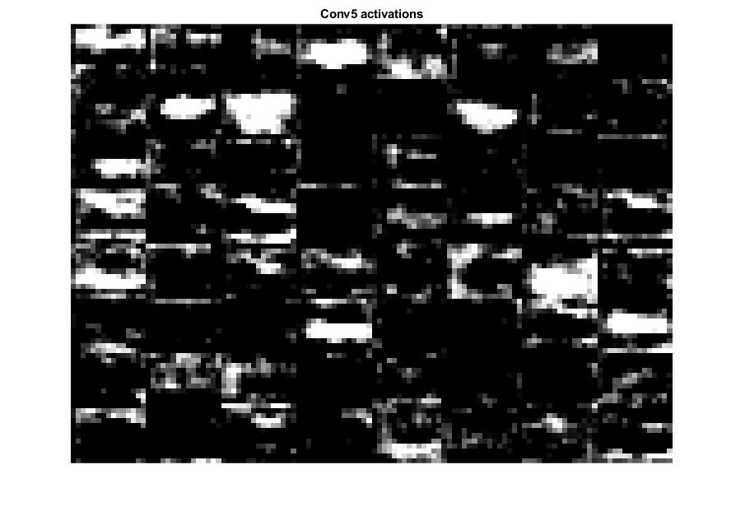
Convolutional Neural Network (CNN) | RESULTS
AlphaNet
Original data training
Feature map (1st convolution)
Feature map (5th convolution)
Augmented data training
BetaNet

Slide 23
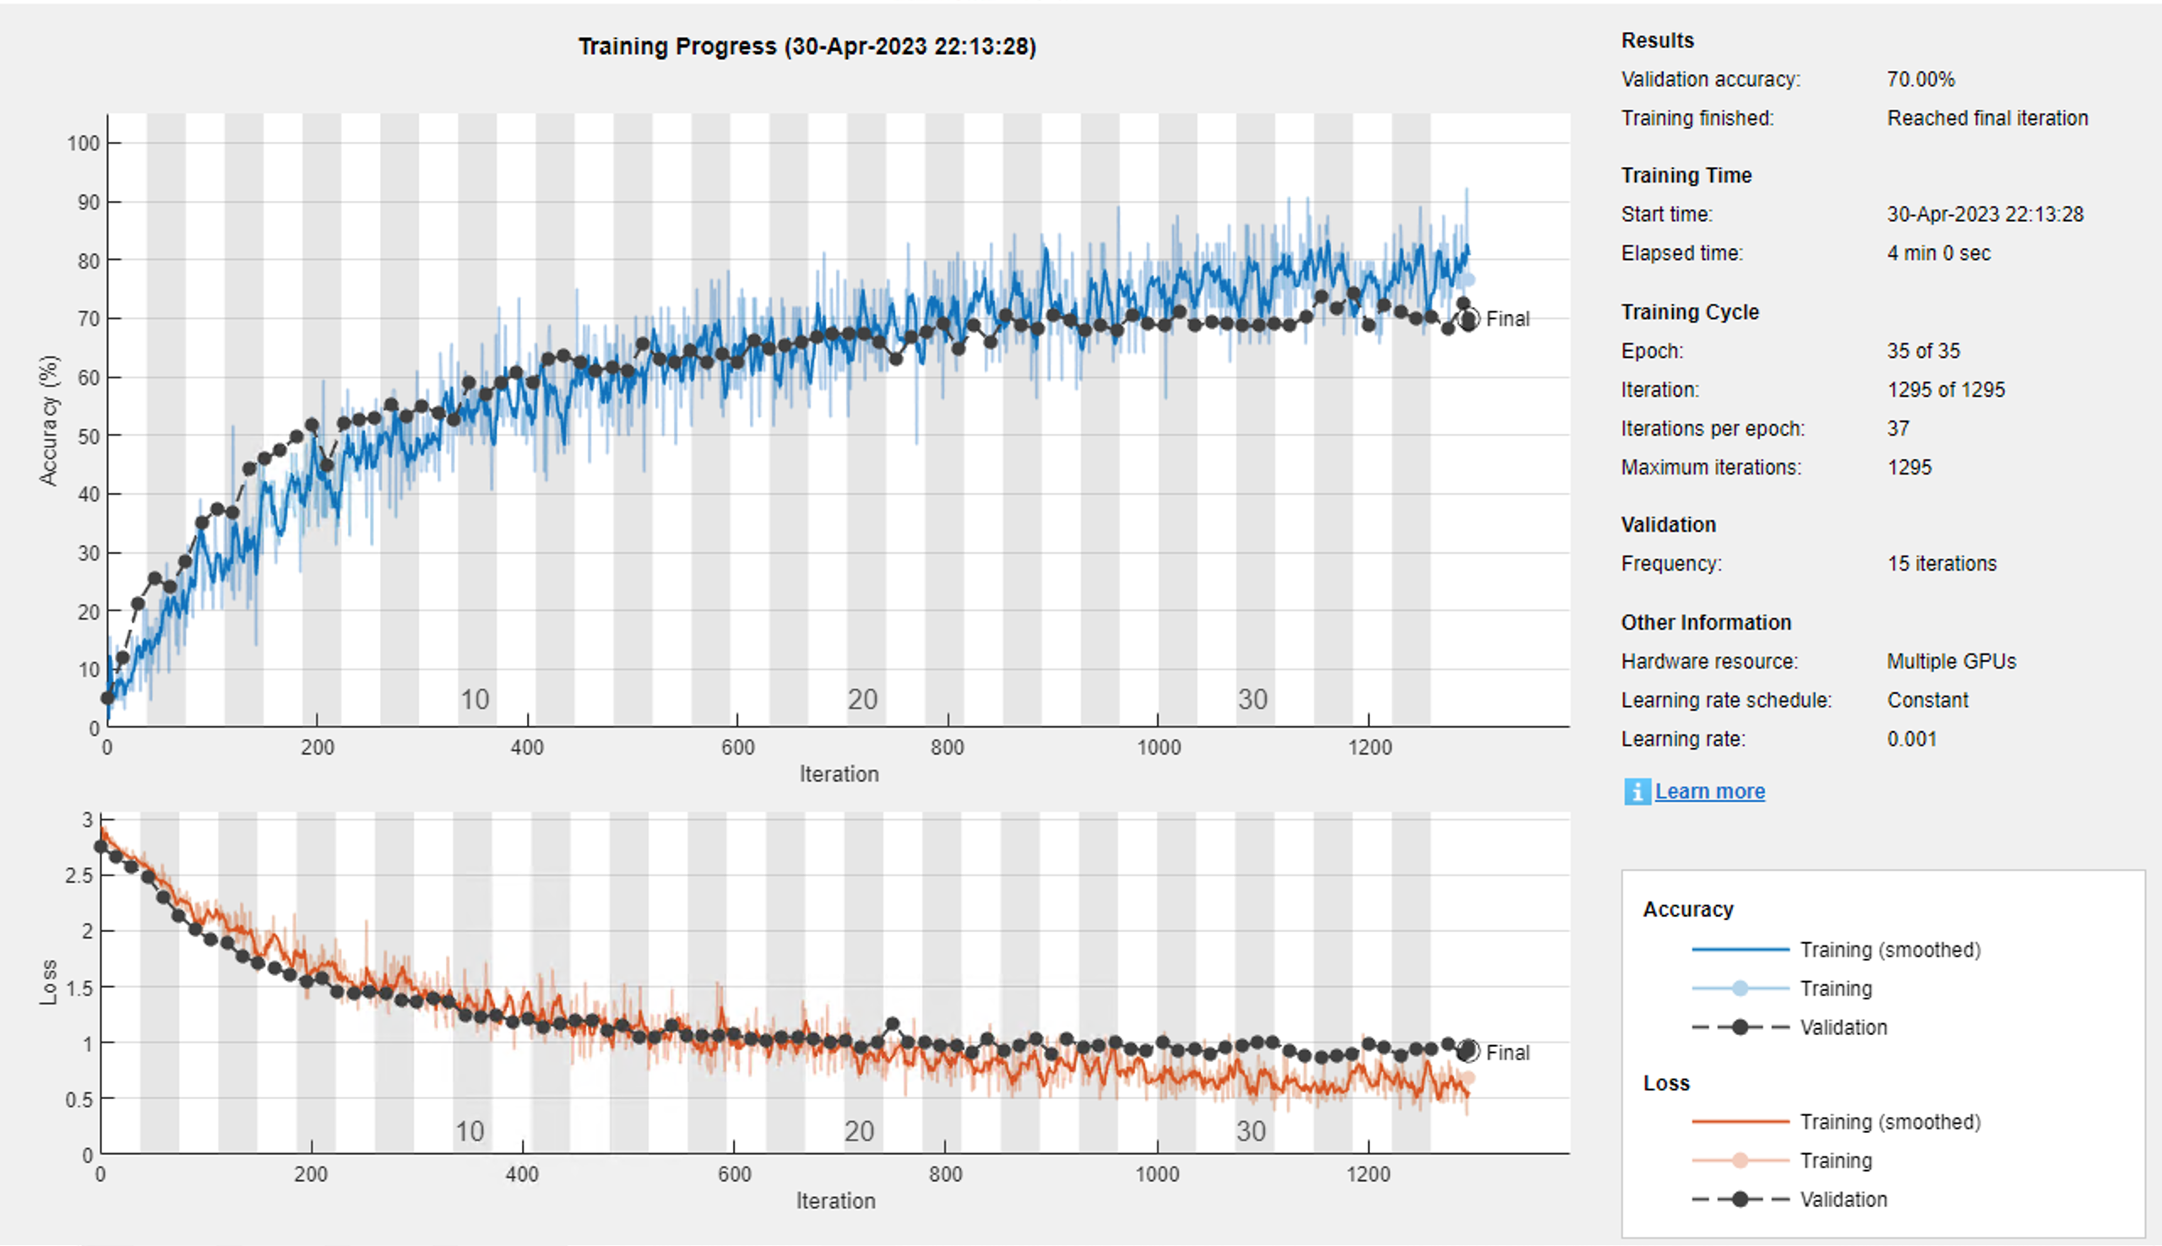
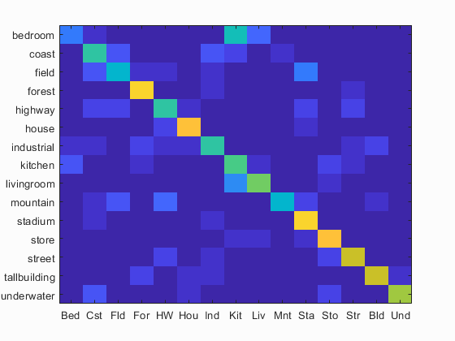
Convolutional Neural Network (CNN) | RESULTS
AlphaNet
Original data training
Augmented data training
BetaNet
Accuracy (mean of diagonal of confusion matrix) is 0.650

Slide 24
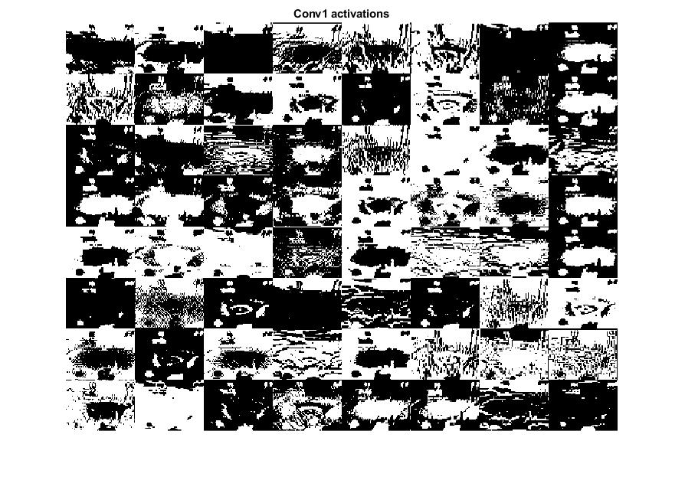
Convolutional Neural Network (CNN) | RESULTS
AlphaNet
Original data training
Augmented data training
Feature map (1st convolution)
Feature map (5th convolution)
BetaNet

Slide 25
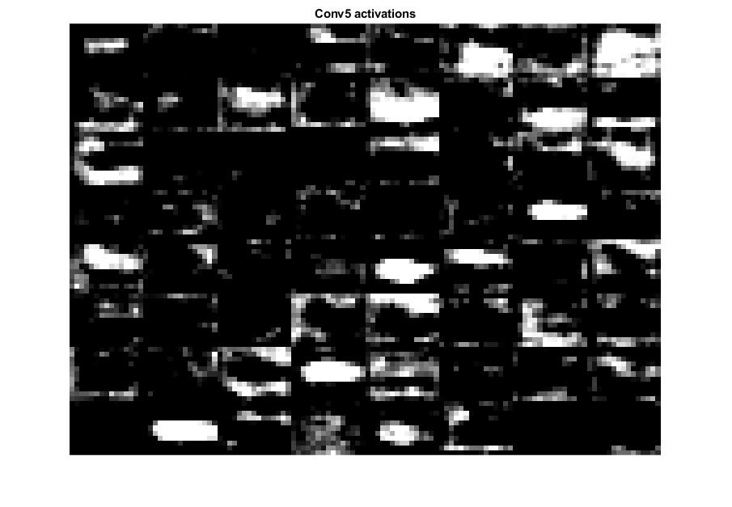
Convolutional Neural Network (CNN) | RESULTS
AlphaNet
Original data training
Augmented data training
Feature map (1st convolution)
Feature map (5th convolution)
BetaNet

Slide 26
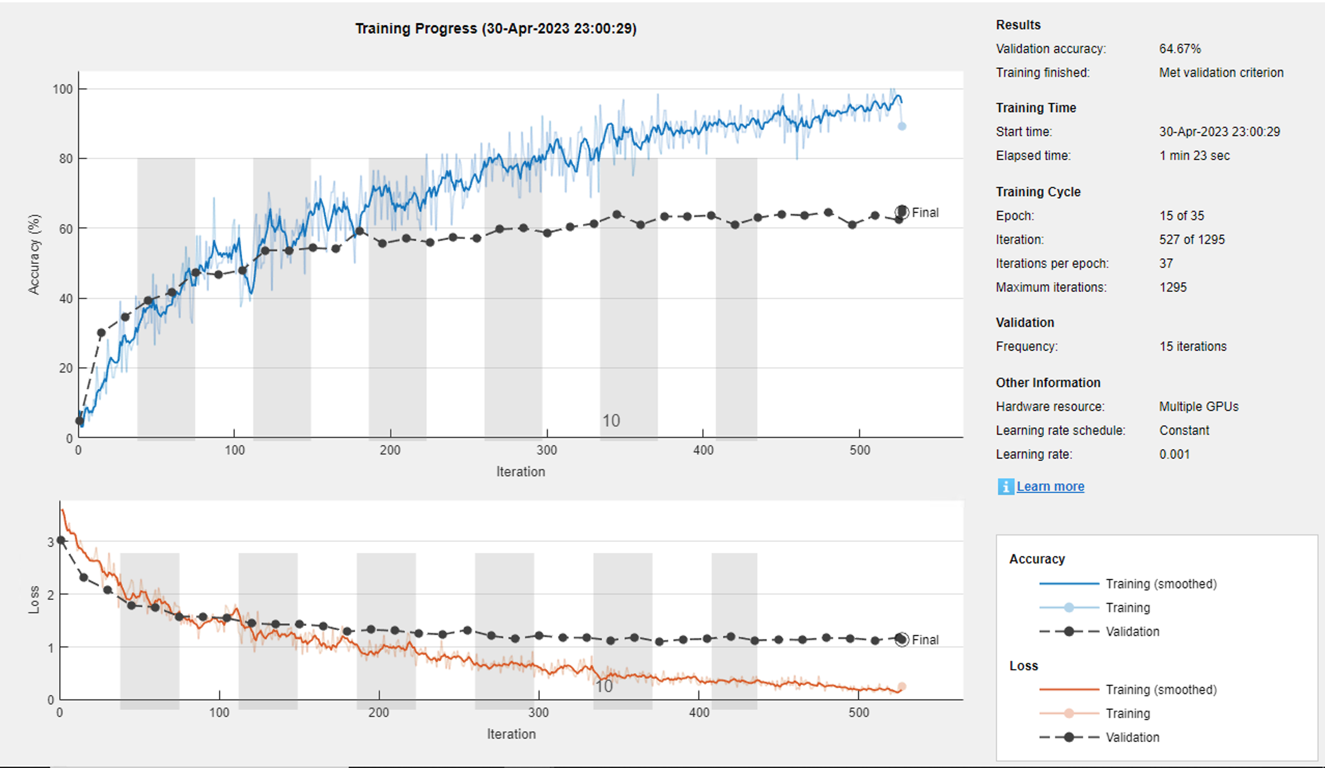
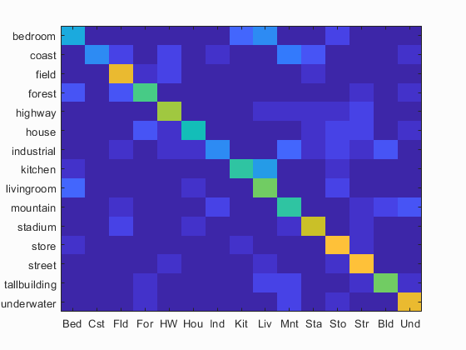
Convolutional Neural Network (CNN) | RESULTS
AlphaNet
BetaNet
Original data training
Augmented data training
Accuracy (mean of diagonal of confusion matrix) is 0.617

Slide 27
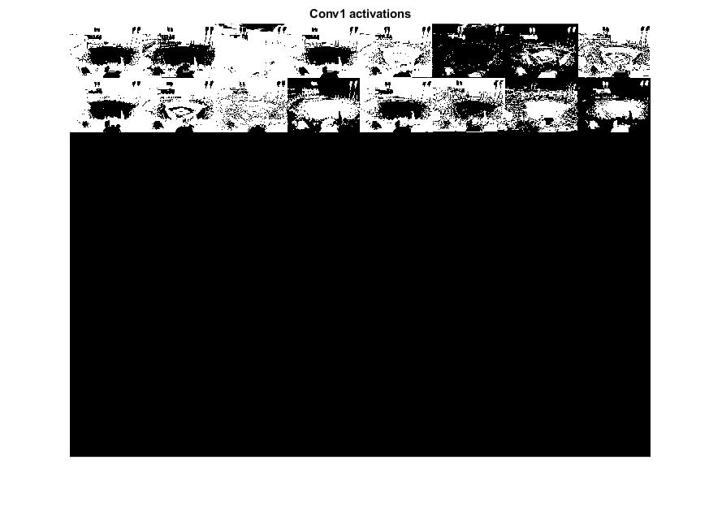
Convolutional Neural Network (CNN) | RESULTS
AlphaNet
BetaNet
Original data training
Feature map (1st convolution)
Feature map (5th convolution)
Augmented data training

Slide 28
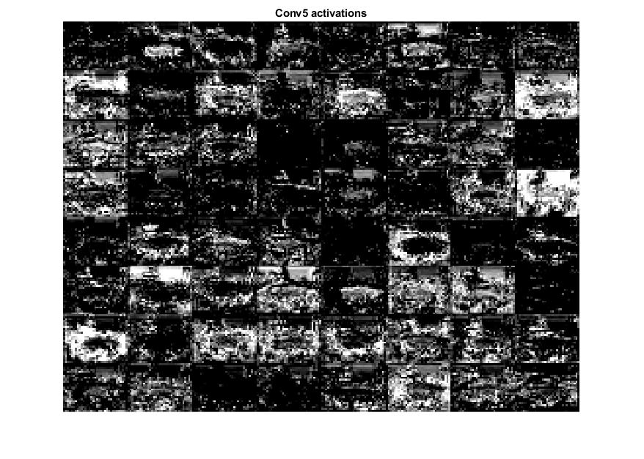
Convolutional Neural Network (CNN) | RESULTS
AlphaNet
BetaNet
Original data training
Feature map (1st convolution)
Feature map (5th convolution)
Augmented data training

Slide 29
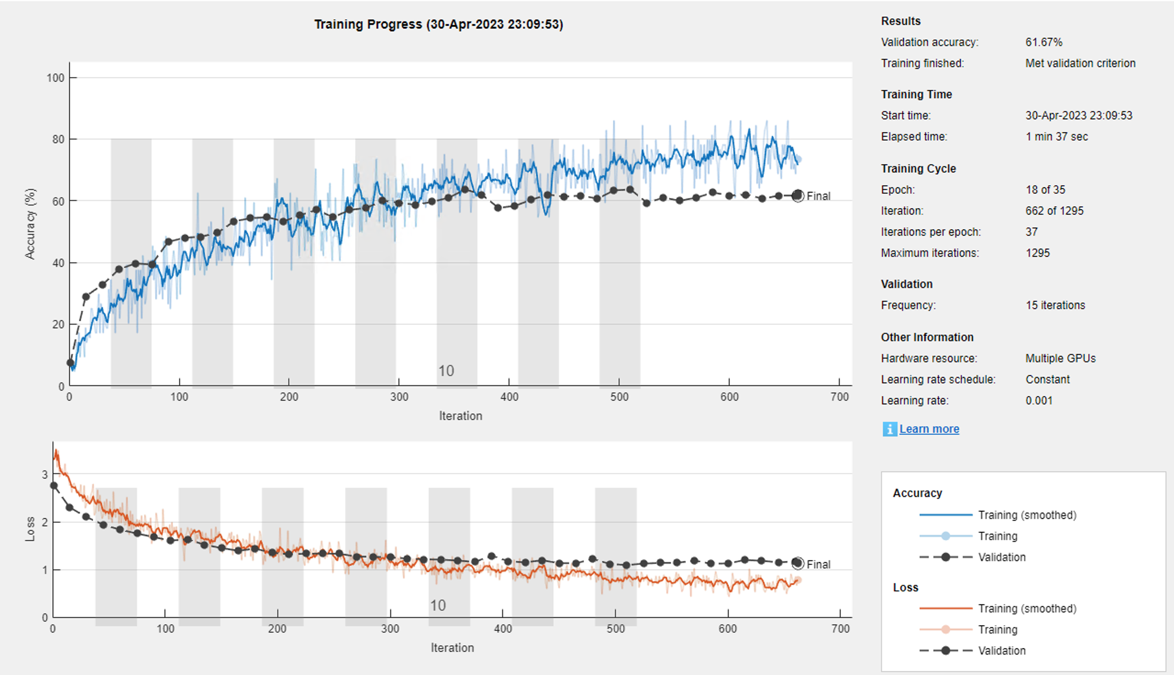
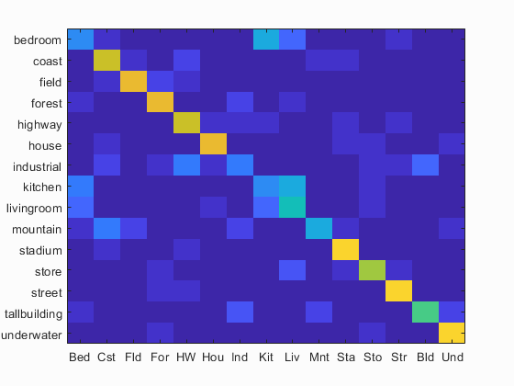
Convolutional Neural Network (CNN) | RESULTS
AlphaNet
BetaNet
Original data training
Augmented data training
Accuracy (mean of diagonal of confusion matrix) is 0.643

Slide 30
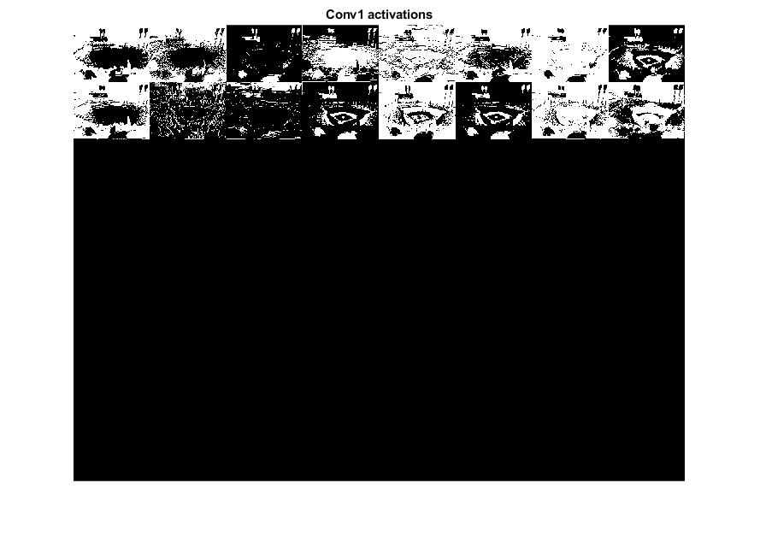
Convolutional Neural Network (CNN) | RESULTS
AlphaNet
BetaNet
Original data training
Augmented data training
Feature map (1st convolution)
Feature map (5th convolution)

Slide 31
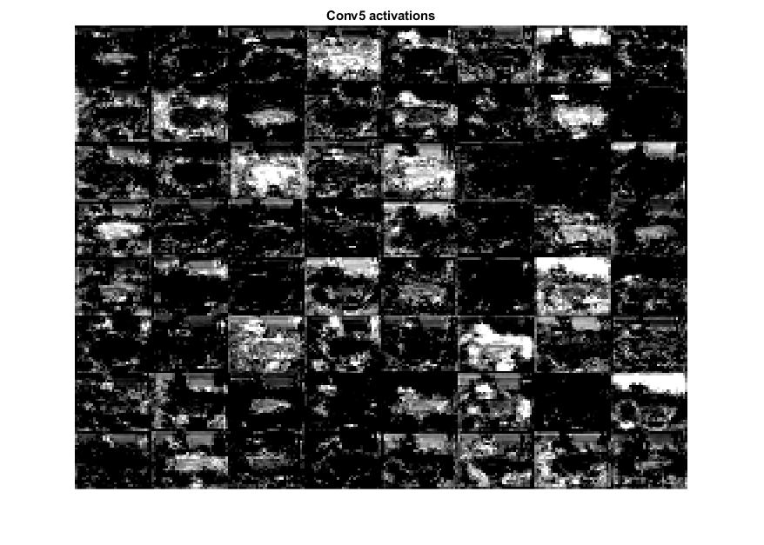
Convolutional Neural Network (CNN) | RESULTS
AlphaNet
BetaNet
Original data training
Augmented data training
Feature map (1st convolution)
Feature map (5th convolution)

